Slide 1


Synapse Real-Time Analytics in Microsoft Fabric
Notes:
Welcome to this episode of the Fabric Webinar Series for Build “Synapse Real-time Analytics in Microsoft Fabric”

Slide 2

A new paradigm in data consumption
Real-Time Analytics in Fabric
Real-Time Analytics Demo
Conclusion
Notes:
We will cover 4 areas,
First we will discuss the new paradigm in data consumption, that has led into a shift about how we think about data.
Then we will go with an overview of Real-time analytics in Fabric to understand its capabilities and how it can help you make the most out of your data to bring your organization into the world of real-time data insights.
But of course, you want to see the platform in action. So, we will go through a demo showcasing some of its capabilities.
And finally, we’ll round it up so you can see what type architectures are ideal for the Real-time Analytics experience in Fabric.

Slide 3
A New Paradigm in Data Consumption
Notes:
A new paradigm in Data Consumption

Slide 4

Paradigm shift in Data Consumption
Notes:
In the past, accessing data was a challenge.
To read a book, you had to go to a library or buy a copy.
To see a movie, you had to go to the cinema or wait for it to air on TV.
And to listen to music, you had to buy a CD or cassette tape, or wait for your favorite song to play on the radio.

Slide 5

Paradigm shift in Data Consumption
Notes:
But today, things have changed.
The internet has revolutionized the way we consume data, making it more accessible to everyone.
Now, you can access a vast array of digital content from anywhere in the world, directly from your mobile phone.

Slide 6

Paradigm shift in Data Consumption
Notes:
A huge variety of applications have made it easier than ever to consume data on the go. For example, if you want to read a book, you can download it onto your e-reader or tablet using your favorite e-book store. This means you no longer have to visit a physical library or bookstore to get a copy.

Slide 7

Paradigm shift in Data Consumption
Notes:
The same goes for movies and TV shows. You no longer have to wait for your favorite program to air on TV or go to the cinema to see a new release. Streaming services provide unlimited access to an enormous library of content, available anytime and anywhere, right from your smartphone.
This shift has truly democratized the way we consume data. Today, most of these activities are done from applications, accessed from your phone.

Slide 8
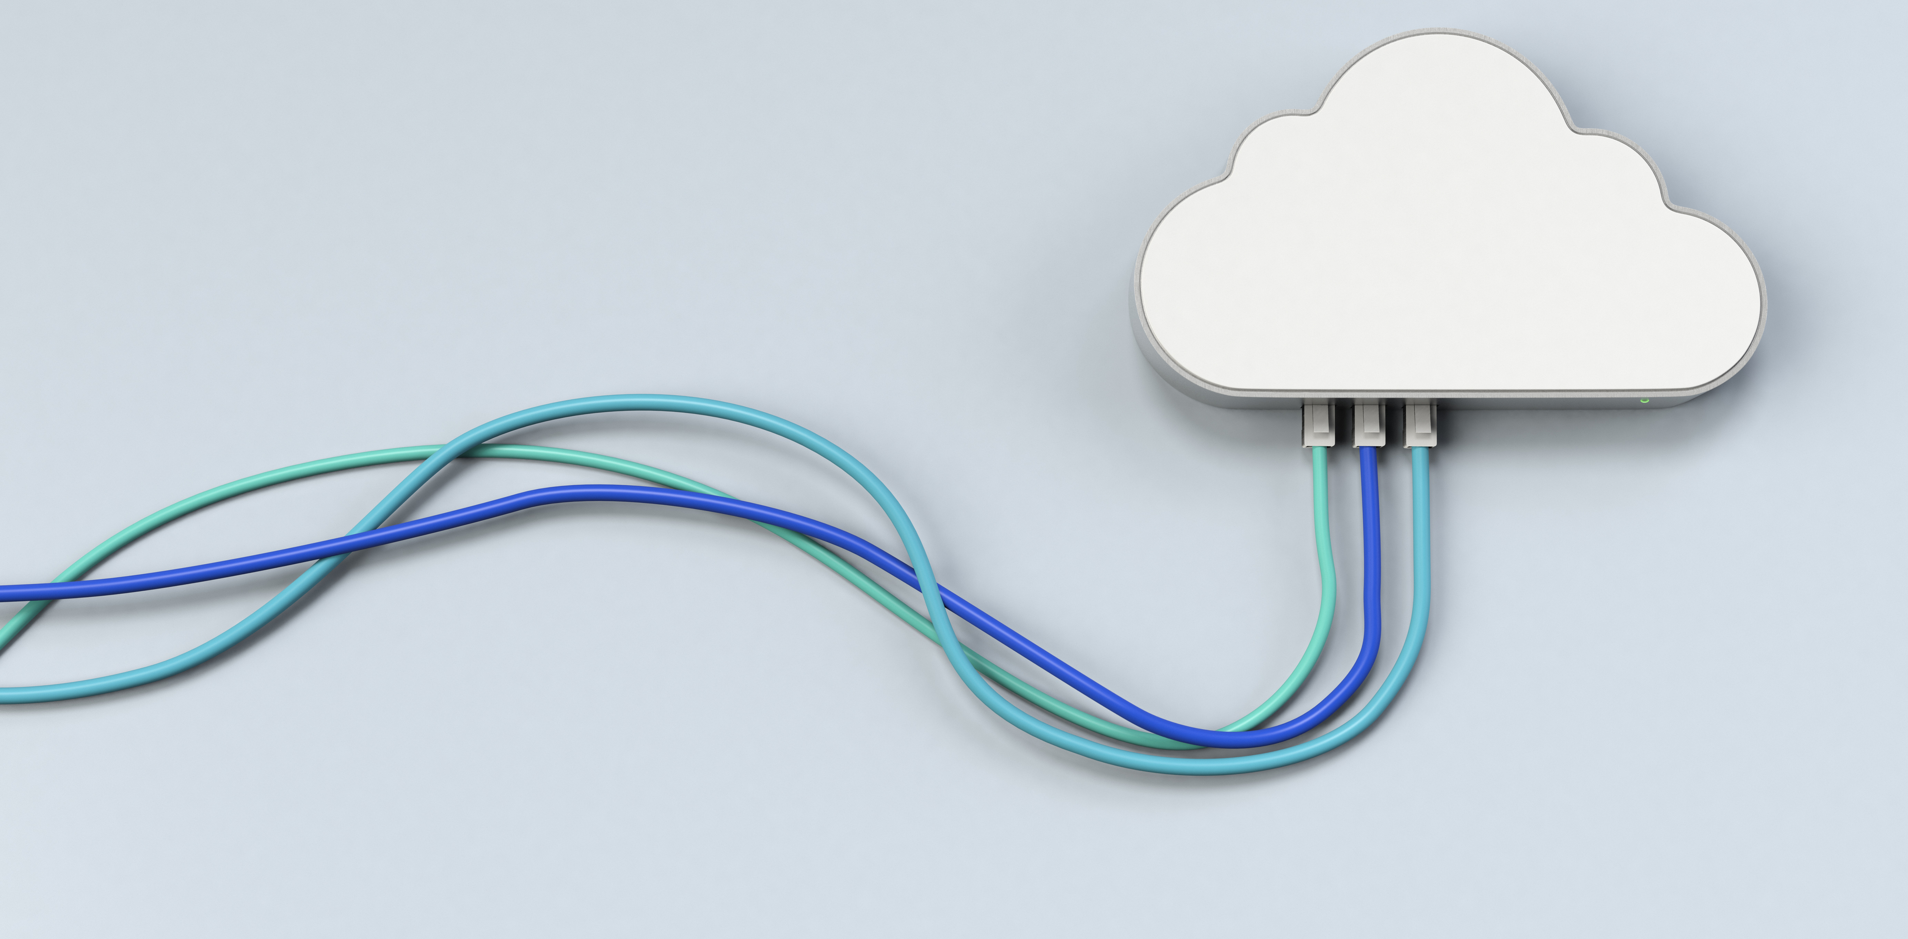
Paradigm shift in Data Consumption
Notes:
Cloud platforms provide the backbone for these experiences, hosting and analyzing the vast amounts of data that drive them.
These platforms are accessible from anywhere in the world, on any device, making it easy to access this data on the go.
Data then, has become interactive, on demand, and available to everyone.

Slide 9

Paradigm shift in Data Consumption
Big Data Platforms
Terabytes of data
Low latency
High freshness
Streaming technologies
Index everything by default
Notes:
This has been made possible by the evolution of cloud technologies and cloud platforms.
Over the past few years, they have become capable of supporting terabytes of data with low latency and high freshness.
Streaming data, from injection to query, is easily accessible by customers. Additionally, data is pre-indexed and pre-partitioned by default.
As a result of these improvements, working with data has become an essential part of the day-to-day workflow for companies all over the world.

Slide 10
Enterprises are still behind in handling real-time data consumption
Notes:
Even as our personal lives have moved towards near-instant data access, enterprises have struggled to keep up.
So, despite the data revolution, many companies are still behind when it comes to fully utilizing their own data to make smart decisions, to improve operations, and customer success.

Slide 11

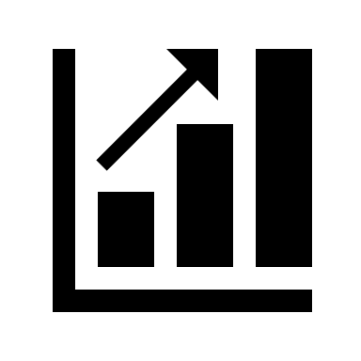

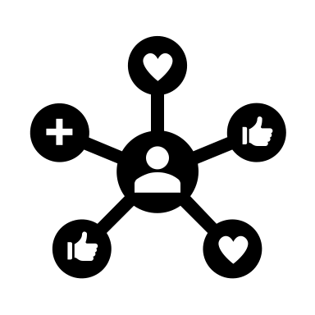
Time for a Digital Transformation
High complexity
High costs of the existing solutions
High Skill
Integration between different teams
Notes:
*High complexity, legacy systems, integration between diff teams, high cost to introduce new people to new technology, people with high skill want to keep with the rhythm, and then don['t want to invest time in learning new technology.
So it’s time for a Digital Transformation at the Enterprise Level
Data analytics has traditionally been a job that requires high skill, it is complex, and current solutions have high costs.
In many cases, generating reports requires experts and programmers to work together to generate the insights that businesses need.
But this rhythm of business makes it hard to onboard new members to the team, scaling the process becoming an issue.
Additionally, due to a mismatch between tools and data formats, the process is often siloed, creating significant barriers to cross-team and cross-department collaboration.

Slide 12

Time for a Digital Transformation
Few experts to generate reports
Long waiting lists
Outdated data
Notes:
This can lead to long waiting times for reports, making the generated insights to quickly become outdated.
But in today's fast-paced business environment, waiting days or weeks for important insights is no longer acceptable.
Is time for platforms to deliever on the digital transformation promise. There’s an inter team dependency. If the CFO needs a new report, they need to ask the business analytics person to get it. Same for the marketing person, if they want to publish a new marketing pitch for their operations. Depend on the data scientists. They don’t have control over the data.
Why is it important to have control over the data.
If we have the data fresh, at hand, we can easily make adjustments, rapidly. We can make the data work for us, becoming an intelligent platform. A marketing person can ajdust their campaigns based on real-time data. A CFO can stop reacting and start being proactive as they see results in real time.
Also this can help operations people predict utilization of resources, not only for devs in the cloud, but think about people having to plan warehouse utilization, or people in the medical field, with time sensitive materials that need to be accomodated as the need arises.

Slide 13
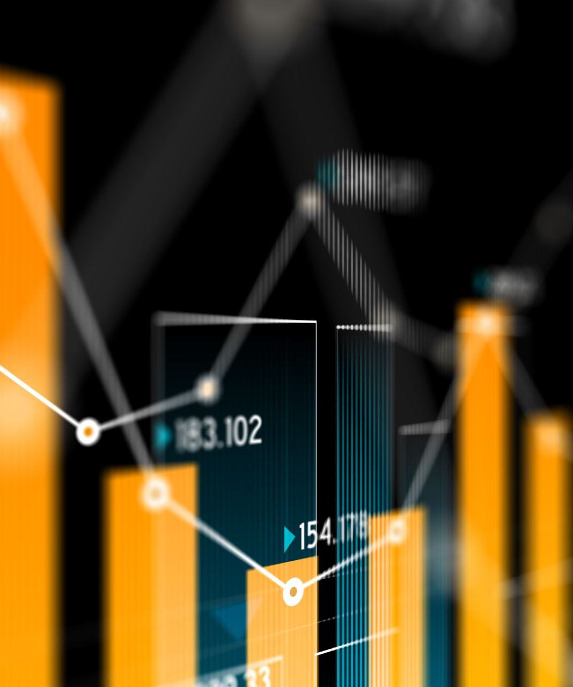
Time for a Digital Transformation
As enterprises rely more on digital technologies for operations and customer interactions, monitoring and analyzing IT systems in real-time have become essential.
Notes:
As enterprises rely more on digital technologies for operations and customer interactions, monitoring and analyzing IT systems in real-time have become essential.
The good news is that at Microsoft we have created a new tool to bring real-time analytics within reach of businesses of all sizes.

Slide 14
Real-Time Analytics in Fabric
Notes:
Real-time Analytics in Fabric

Slide 15
With Real-Time Analytics in Fabric, we help organizations scale up their analytics solution and democratize data for advanced and citizen data scientists.
Notes:
With Real-time analytics in Fabric we want to bring the paradigm shift that happened in our real lives to the business world.
In the same way today you can just go and buy books, music or movies online, we want you to have the same “easy to use” and friendly experience when it comes to working with real-time data.
By democratizing data for both citizen and advanced data scientists, we created a powerful analytics solutions that can be used by anyone in you organization, regardless of their expertise or job duties.
The result is a more agile, data-driven organization that is better equipped to take on the challenges of today's dynamic business environment.

Slide 16
Real-Time Analytics is built on top of Azure Data Explorer Engine
Notes:
The Real-time Analytics experience in Fabric, is built on top of Azure Data Explorer Engine, AKA Kusto, with a focus on accessibility, having full integration with other Fabric experiences

Slide 17

Real-Time Analytics in Fabric - Reducing Complexity
One Logical Copy
By-default streaming ingestion
By-default indexing everything
Time and Hash based data partitioning
Native support for structured, semi-structured and free text data
In-place transformation
Notes:
Here’s how we reduce complexity with Real-time Analytics in Fabric.
Fabric offers support for a single logical copy of your data, to help maintain consistency and eliminate data silos.
Streaming ingestion is enabled by default, so you can import data continuously.
Data is partitioned by both time and hash by default, so you don’t need to worry about scalability and query performance during data ingestion.
Also, data is indexed by default, making it easy to search and analyze later.
There’s native support for structured, semi-structured, and free text data, so you can analyze any type of data in your organization.
For example, our solutions will automatically infer the shape of the data and create tables based on that shape.
Also, you can transform data in-place as needed without moving it to a separate system.

Slide 18
Real-Time Analytics in Fabric - Simplifying
Tightly integrated with Fabric experiences
Mirroring to Lakehouse
By-default integration with event streaming sources
By-default integration with Power BI
Notes:
By being integrated with other Fabric experiences, Real-time analytics also simplifies how you work with your data.
You can easily create Power BI reports on every dataset or explore them via notebooks.
By-default integration with event streaming sources lets you ingest data in real-time from sources like Azure Event Hubs.
All this can be achieved via a no-code, drag and drop user experience.
This helps to ensure that everyone has access to the same data and insights, which is essential for making informed business decisions.

Slide 19



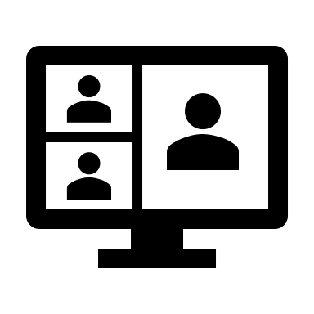
Real-time Analytics in Fabric
Auto-managed scale
Cross workload solutions
Easy onboarding with friendly UX
Managed experiences
Notes:
Thanks to being powered by Azure Data Explorer, you can store, query, and gain insights into vast amounts of data.
The system is highly scalable and optimized for performance, able to adjust capacity to your usage patterns and needs, allowing for seamless performance no matter the number of users.
With an intuitive query language like KQL, everything is easy to get started with.
Also, the system is fully managed, so you can focus on your data and your business, without having to worry about scaling or partitioning.

Slide 20
Solving the
Single Source of Truth
problem
Notes:
Also, by being fully integrated with other Fabric experiences, with Real-time Analytics, we've solved the single source of truth problem.
We've consolidated all your data into one central workspace, so you can be confident that you're working with the most accurate, up-to-date information.

Slide 21
Real-time Analytics - Key capabilities
Unlimited scale (query, ingestion, storage)
Any data source
Any data format
Structured, semi-structured, free-text data
Notes:
Many artifacts Messaging with Even Hubs, KQL database, KQL queryset.
Any data soource: different clouds, on prem. CSV, parquet.
You can query text, json, arrays, structured data.

Slide 22
Real-time Analytics - Key capabilities
Real-time data transformation of complex data structures
Streaming analytics in Near Real Time
High performance, Low latency, freshness
Notes:
Built-in streaming. 200gb per core per minute
Access the data in seconds, once ingested
Suppots time series.

Slide 23


Highlighted industry scenarios
IOT Analytics
Log analytics (security)
Notes:
Some of the highlighted industry scenarios for Real-time Analytics are IOT Analytics and Log analytics

Slide 24

Highlighted industry scenarios
Cybersecurity
Asset tracking and management
Predictive maintenance
Supply chain optimization
Customer experience
Energy management
Notes:
Which you can extend across different industries, like:
Cybersecurity
Asset tracking and management
Predictive maintenance
Supply chain optimization
Customer experience
Energy management

Slide 25
Highlighted industry scenarios
Inventory management
Quality control
Environmental monitoring
Fleet management
Health and safety
Notes:
Also you can use real-time analytics for scenarios like
Inventory management
Quality control
Environmental monitoring
Fleet management
Health and safety
Basically, if you have time based events that require data streaming, like telemetry data, then with Real-time analytic you are at the right place.

Slide 26
Real-time Analytics Demo
Notes:
Let’s see a demo of Real-time analytics in action.
In this demo we are going to create a real-time analytics solution, ingesting streaming data from Eventstream and then using the KQL Database for creating a real-time
refreshing Power BI report.

Slide 27
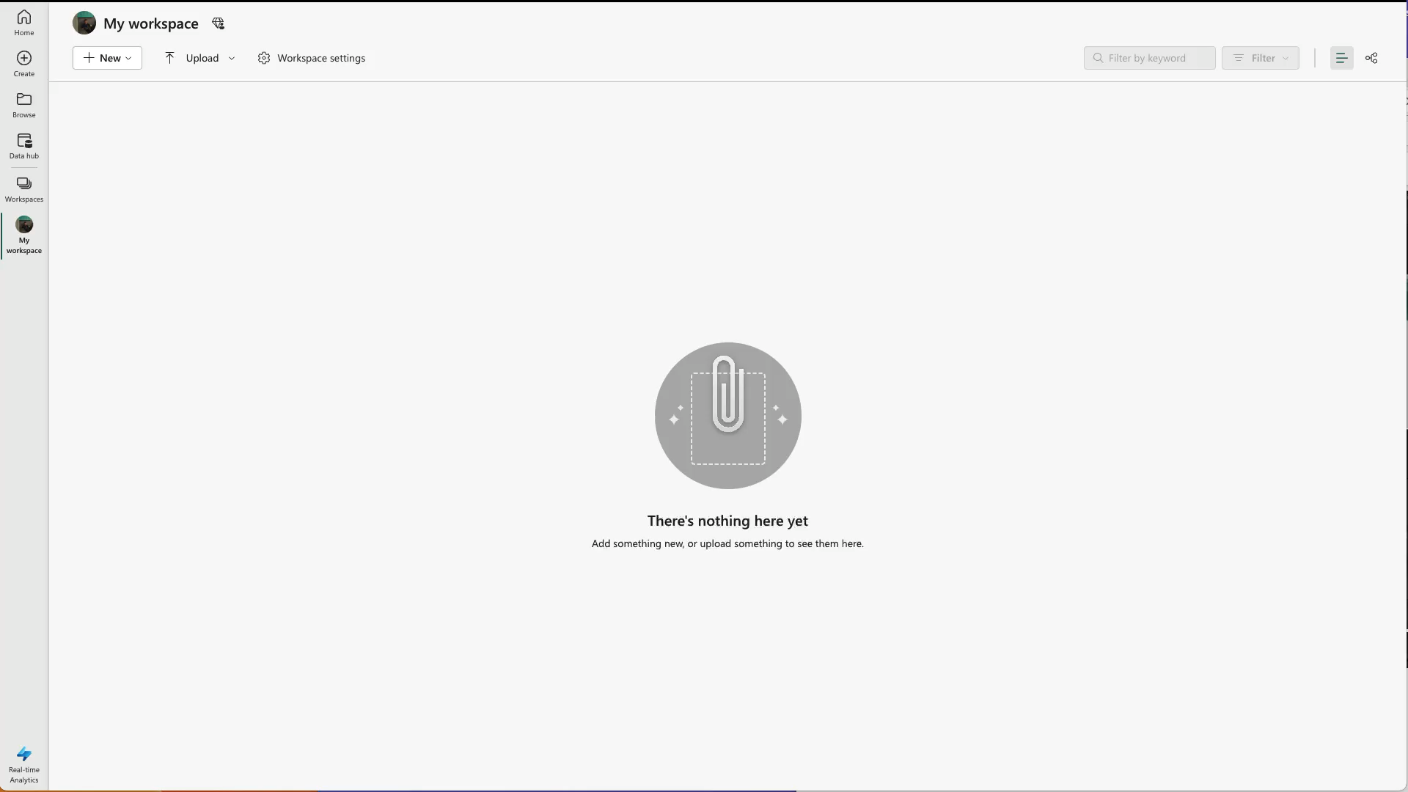
Real-time Analytics Demo
Notes:
# demo script
In this step, you will create a Fabric workspace that will contain all the artefacts needed for real-time analytics including KQL Database, Eventstream, Power BI datasets, and reports.
## Create a Fabric workspace
Select Workspaces > New Workspace
And then fill out the Create a workspace form by giving it the name: Fabric Real-time Analytics Tutorial
You can leave all the other fields as they are.
Then click Apply
The interface will change to the new workspace you just created.
## Create a KQL Database
Now it’s time to create the KQL database.
Select New > KQL Database
On the New KQL Database dialog, enter a unique name.
Since we are going to use the New York City Yellow Taxi database, we’ll call it NycTaxiDB
Then select Create.
Once provisioning is complete the KQL database editor landing page will be shown
## Add a Mirroring policy
Finally, we are going to run a query to enable a mirroring policy on the database to mirror one logical copy in OneLake
Select Database in the Object tree.
Then Select Check your data.
And then we use the following .alter-merge query to enable mirroring
## Create an Eventstream
Let's go back to the Workspace to to create an Eventstream to stream data into the KQL database.
Select New > EventStream
On the New Eventstream dialog, enter NyTaxiTripsEventstream as the name, and select Create.
Once provisioning is complete the Eventstream landing page will be shown.
Now we are going to configure the Eventstream to stream data into the KQL database.
Select New Source > Sample data
Enter nytaxitripsdatasource and choose Yellow Taxi from the sample data dropdown.
Then select Create.
Then select New Destination and choose KQL Database.
Enter nytaxidatabase and choose your Fabric workspace from the dropdown, and then select the KQL database that you created before.
Then select Create and Configure.
In the Destination tab, select New table and enter nyctaxitrips as the table name.
Select Next: Source.
In the Source tab, keep the default values, select Next: Schema.
In the Schema tab, choose JSON as the Data format dropdown.
After choosing JSON as the Data format, data preview will refresh and show the data in strongly typed columns.
Here you can change the data type of the inferred columns to match your needs.
Select the arrow next to VendorID column name, choose Change data type, and then choose int.
As shown in the previous step, choose datatype as long for the columns passenger_count, PULocationID, DOLocationID and payment_type.
Then Select Next: Summary.
In the "Continuous ingestion from Event Stream is in progress" window, all steps will be marked with green check marks when the data connection is successfully created.
The data from Eventstream will begin streaming automatically into your table.
Now it’s time to explore the data with Power BI
# Explore data and build Power BI report
Navigate to your Fabric workspace, select your KQL Database.
In the object tree, select the table nytaxitrips
In the top right corner, select Check your data.
Then we will paste the following query to create a summarize fare amounts grouped by hour of day.
Once you run the query you will see the results in the table below.
Select Build Power BI Report. An Empty PowerBI report editing window will open.
Select Stacked Column Chart in the Visualizations pane. Drag HourOfDay field to X-axis and
avg_fare_amount to Y-axis
Select File menu and then Save in the top left corner
Enter nyctaxitripstats in the Name your file in Power BI field, choose your workspace and choose sensitivity as Public.
Once the report is saved, click on the link Open the file in Power BI to view, edit, and get a shareable link.
Click on Edit button to edit the Power BI report.
Choose Format your report page, and Toggle Page Refresh to On.
Expand Page Refresh and set the refresh interval to 10 seconds.
Then Save your report.
With this tutorial, you have now built an auto-refreshing Power BI report that is querying streaming data arriving in KQL Database from Eventstream.

Slide 28
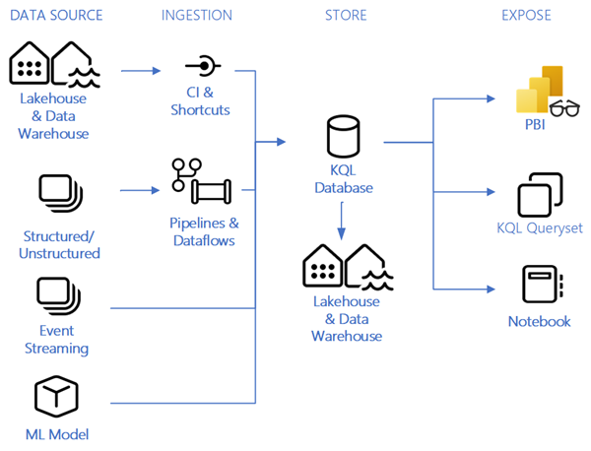
Real-time Analytics
Notes:
As you could see in the demo,
You can stream data from Event Hubs directly into Real-Time Analytics.
The underlying Kusto engine is able to detect the data format, and infer the database table structure from it.
Then you can query the data directly by using KQL.
Thanks to the Power BI integration, you can visualize the data to gain powerful insights from it, all into a managed experience in Fabric.

Slide 29
Conclusion
Notes:
In conclusion, when to use Real-Time Analytics?
If any one of these questions describes your data needs, Real-Time Analytics is the right solution for you:
Do I need high freshness from data ingestion to query?
Do I have a service that needs to access data with low query latency (in a matter of seconds)?
Do I need to search or access data in different formats, like structured data, semistructured data like JSON, or unstructured data (for example, free text)?
Do I want the ability to query large amounts of data?
Does my data have a time component that can benefit from the time series-optimized database structure?
Do I want the ability to create ad hoc queries on any field or row without prior optimization?
As you can see the new paradigm shift in data consumption is here, and with Real-Time Analytics we can help transform your organization today.

Slide 30
Try for free fabric.microsoft.com
Learn more microsoft.com/fabric
Notes:
So, what’s next for you? The best way to discover the new Microsoft Fabric is to experience it. Head over to fabric.microsoft.com to start your free trial. And if you want to learn more, head over to microsoft.com/fabric to get access to more resources, learning materials and a community to guide you through your experience. I’ll meet you there.
Have a great day!

